Slide 1

DSO 530 Final Project
Zhuoqun SHENG
He YOU

Slide 2
Background, Observations, and Procedures
Assumptions and Variables
Analysis into IMDb Score
Analysis into Gross
Conclusions and Program Improvements

Slide 3
Background, Observations, and Procedures
IMDb data for 5000 movies was exported from Kaggle.com
2589 unique, post-2000 U.S. movie titles were analyzed
The goal is to analyze the relationship between gross and IMDb score with the other variables.
To find insights in movie industry and try to find profitable movie package for investors.

Slide 4
Assumptions & Variables
Assumptions
Gross reflects popularity in movie market
IMDb score reflects public praise
Dependent variables: IMDb score and gross
A categorical dependent variable was created using IMDB score – if IMDb_score >= 7, value = 1, otherwise value = 0.
The threshold of 7 was selected because group members would be more likely to watch a movie if it had a score of 7+.
Independent variables: budget (numerical), duration (numerical), movie Facebook likes (numerical), actor 1-3 Facebook likes (numerical), cast Facebook likes (numerical), Director Facebook likes (numerical), number of critics (numerical), number of voters (numerical), genre (categorical), plot keywords (categorical), title year (numerical), actor 1-3 (categorical), director (categorical)

Slide 5
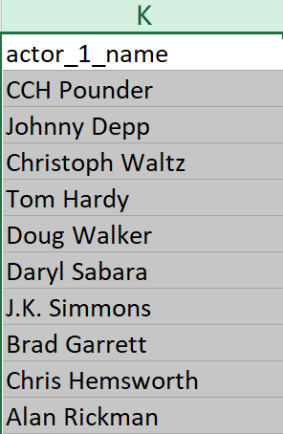
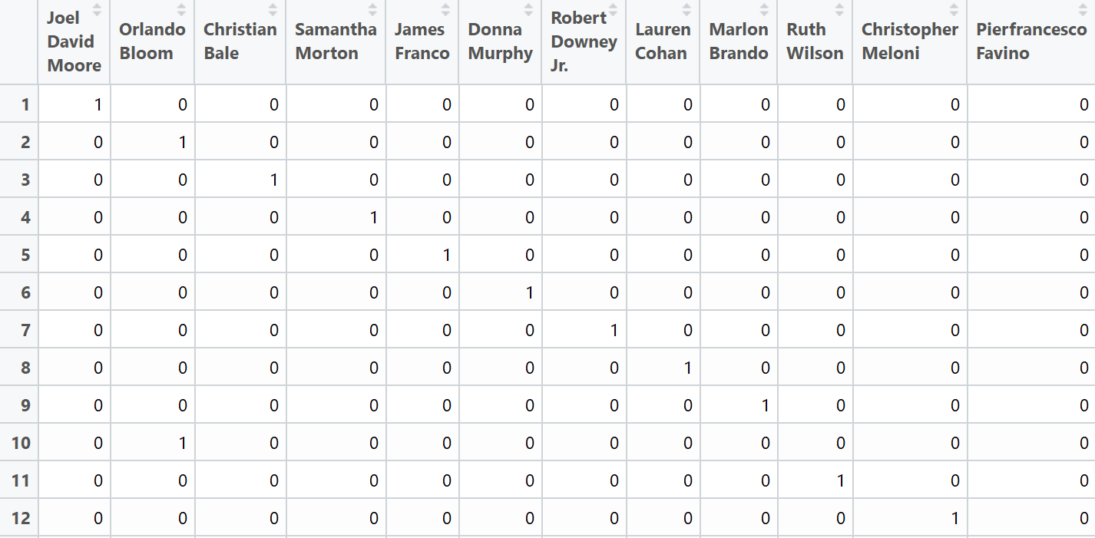
Procedure
Firstly, we separate the original variables “Keywords”, “Genres”, “Directors”, ”Actors” into several individual variables.
There are 23 genres, 3549 actors, 1445 directors, 5253 keywords in this dataset in total

Slide 6
Procedure
Secondly, we do some preparatory work
For example: (1) We calculate gross and budget in million, so that
budget will not be over-valued in this model.
(2)75% of whole dataset is regarded as train_data while
rest of them is used as test_data
Thirdly, we analyze how numerical variables influence the IMDb_score and Gross
Logistic regression, LDA, QDA and KNN methods are used to
measure the IMDb_score whether higher than 7.
Linear regression is used to measure the Gross

Slide 7
Procedure
Fourthly, we analyzed how genres, directors, actors and keywords impact on IMDb score and gross
Ridge regression is used to compare individual variable
Lasso regression is used to identify which variables have significant
influence on IMDb score and gross
Finally, we made comprehensive analysis
Data visualization is used to identify which particular genre, director or
actor is special

Slide 8
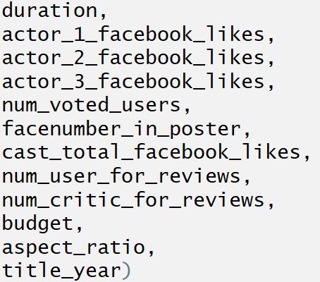
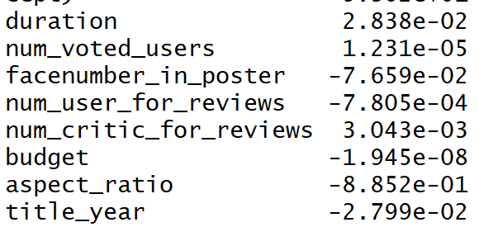
Analysis into IMDb Score
Numerical variables
LDA model is best. The misclassification error is 0.141
Nothing related to Facebook
Recent year tend to have lower IMDb score
Notes:
We assume that gross has relationship with both production and marketing process, thus gross is probably affected by factors including budget, duration and popularity of director and cast (which is reflected by Facebook likes). Additionally, gross is also affected by word-of-mouth marketing online, which could be reflected through IMDb score, number of voted users and number of critics for reviews.

Slide 9
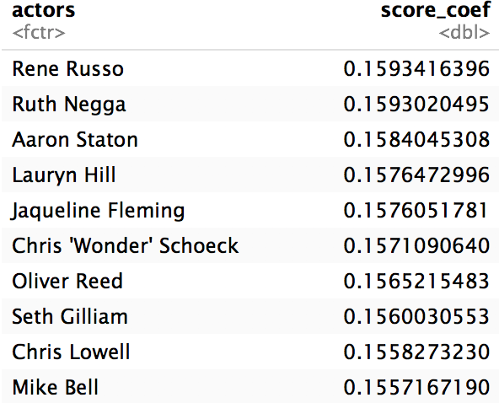
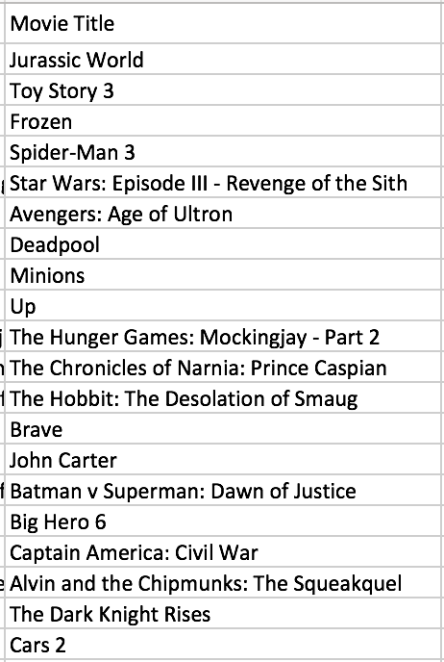
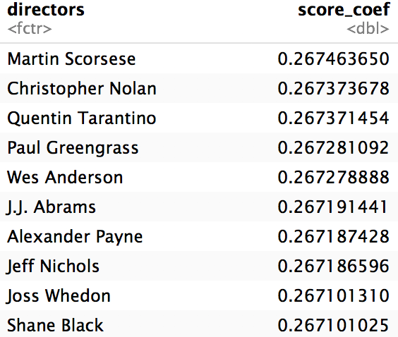
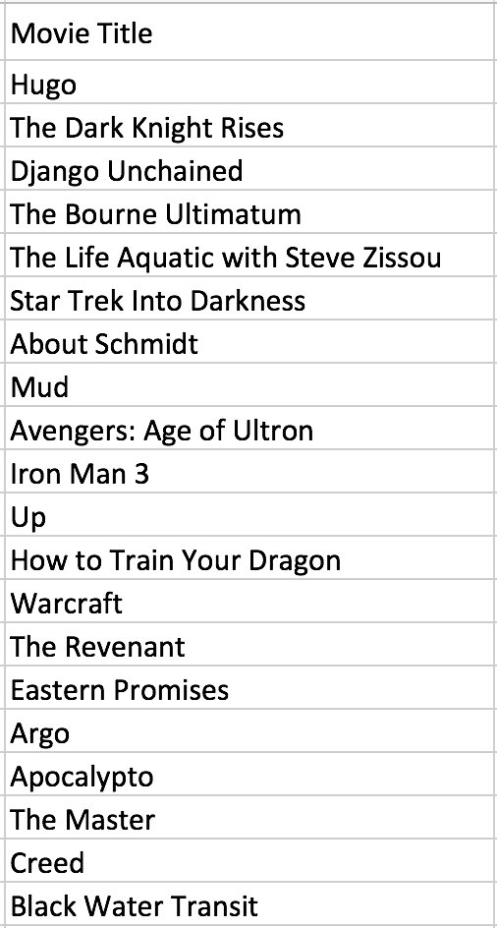
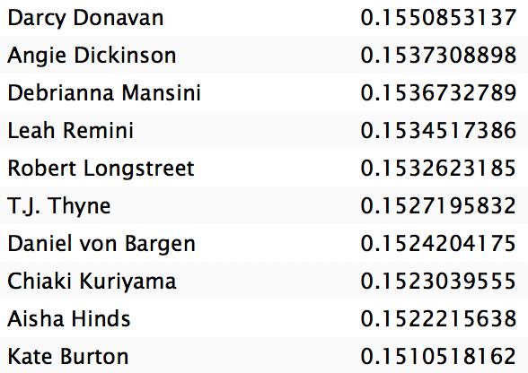
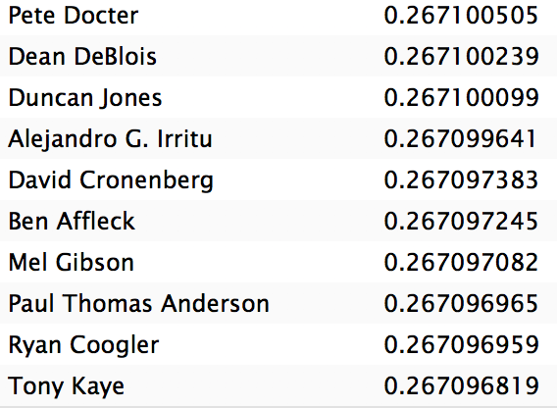
Analysis into IMDb Score
Directors and Actors –Top 20 Score identified by Ridge model
Notes:
We assume that gross has relationship with both production and marketing process, thus gross is probably affected by factors including budget, duration and popularity of director and cast (which is reflected by Facebook likes). Additionally, gross is also affected by word-of-mouth marketing online, which could be reflected through IMDb score, number of voted users and number of critics for reviews.

Slide 10
Analysis into IMDb Score
Actors – Highest Score
Notes:
We assume that gross has relationship with both production and marketing process, thus gross is probably affected by factors including budget, duration and popularity of director and cast (which is reflected by Facebook likes). Additionally, gross is also affected by word-of-mouth marketing online, which could be reflected through IMDb score, number of voted users and number of critics for reviews.

Slide 11
Analysis into IMDb Score
Using the lasso regression, we could identify the ratio of variables have signification impact on the dependent variables.
21.7% of genres have significantly impact on IMDb score.
None of actors, keywords, directors have significantly impact on IMDb score.
That may because we use IMDb score as a categorical variable rather than numerical. This result could be improved if we change the attribute of the IMDb score in further research.
Notes:
We assume that gross has relationship with both production and marketing process, thus gross is probably affected by factors including budget, duration and popularity of director and cast (which is reflected by Facebook likes). Additionally, gross is also affected by word-of-mouth marketing online, which could be reflected through IMDb score, number of voted users and number of critics for reviews.

Slide 12
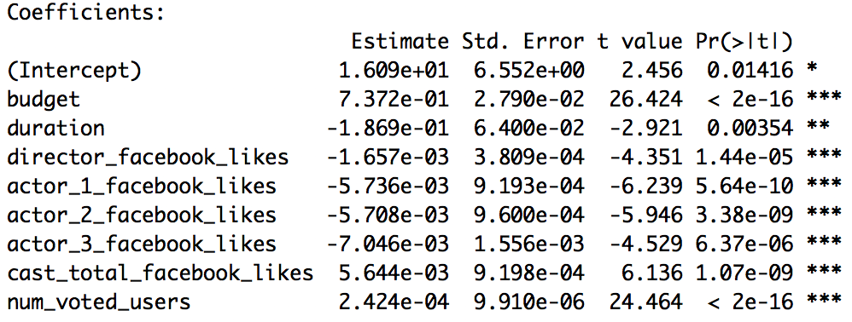
Analysis into Gross
Linear Regression Analysis
Variables:
budget, duration, title year, director Facebook likes, actor 1 Facebook likes, actor 2 Facebook likes, actor 3 Facebook likes, cast total Facebook likes, movie Facebook likes, number of voted users, number of critic for reviews, face number in poster.
Budget has strong positive effects on gross.
Duration has an obvious negative relationship with gross.
Facebook likes of staff seems to have little to do with gross.
Number of voted users has a slight positive relationship with gross.
Notes:
We assume that gross has relationship with both production and marketing process, thus gross is probably affected by factors including budget, duration and popularity of director and cast (which is reflected by Facebook likes). Additionally, gross is also affected by word-of-mouth marketing online, which could be reflected through IMDb score, number of voted users and number of critics for reviews.

Slide 13
Analysis into Gross
Ridge Model and Lasso Model Analysis
Variables:
Genres, Keywords, Directors, Actors
Notes:
We assume that gross has relationship with both production and marketing process, thus gross is probably affected by factors including budget, duration and popularity of director and cast (which is reflected by Facebook likes). Additionally, gross is also affected by word-of-mouth marketing online, which could be reflected through IMDb score, number of voted users and number of critics for reviews.

Slide 14
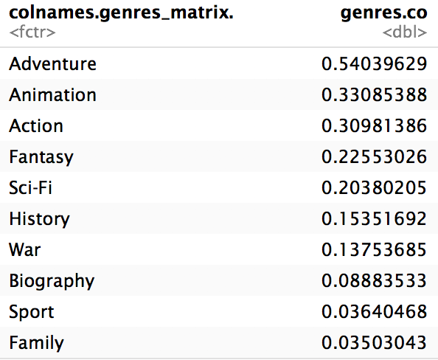
Analysis into Gross
Genres – Ridge Model
78.26% genres contribute to gross
Notes:
We assume that gross has relationship with both production and marketing process, thus gross is probably affected by factors including budget, duration and popularity of director and cast (which is reflected by Facebook likes). Additionally, gross is also affected by word-of-mouth marketing online, which could be reflected through IMDb score, number of voted users and number of critics for reviews.

Slide 15
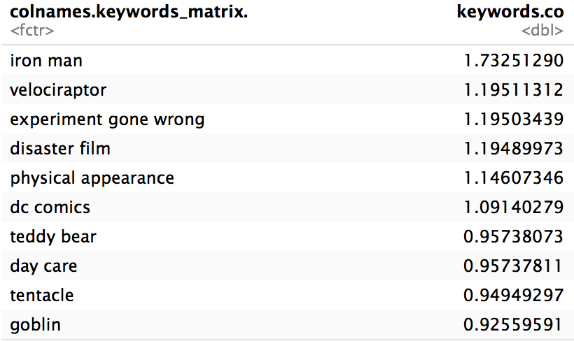
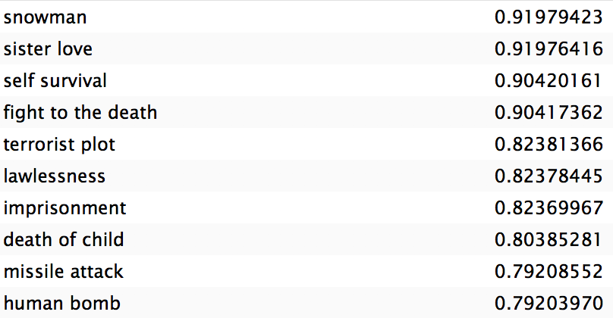
Analysis into Gross
Keywords – Ridge Model
1.24% keywords contribute to gross
Notes:
We assume that gross has relationship with both production and marketing process, thus gross is probably affected by factors including budget, duration and popularity of director and cast (which is reflected by Facebook likes). Additionally, gross is also affected by word-of-mouth marketing online, which could be reflected through IMDb score, number of voted users and number of critics for reviews.

Slide 16
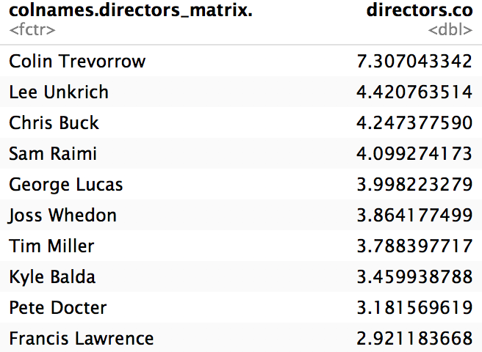

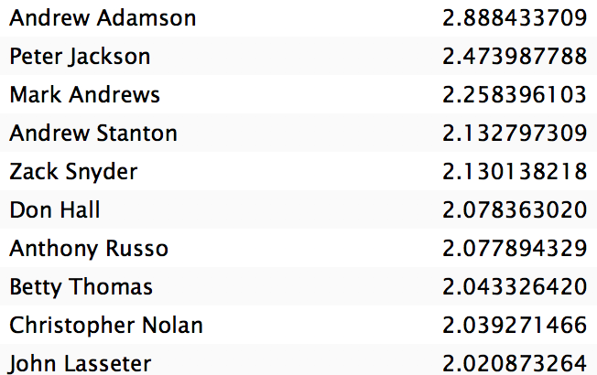
Analysis into Gross
11.54% directors contribute to gross
Directors – Highest Gross
Notes:
We assume that gross has relationship with both production and marketing process, thus gross is probably affected by factors including budget, duration and popularity of director and cast (which is reflected by Facebook likes). Additionally, gross is also affected by word-of-mouth marketing online, which could be reflected through IMDb score, number of voted users and number of critics for reviews.

Slide 17
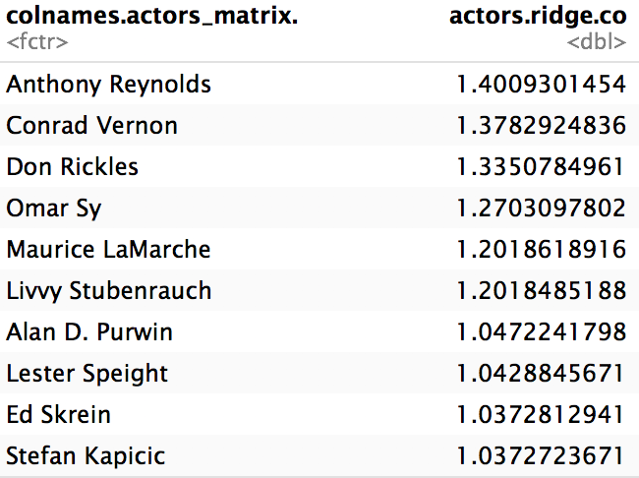
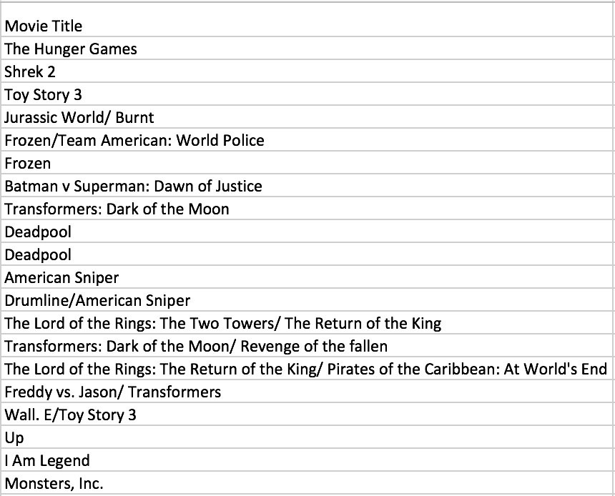
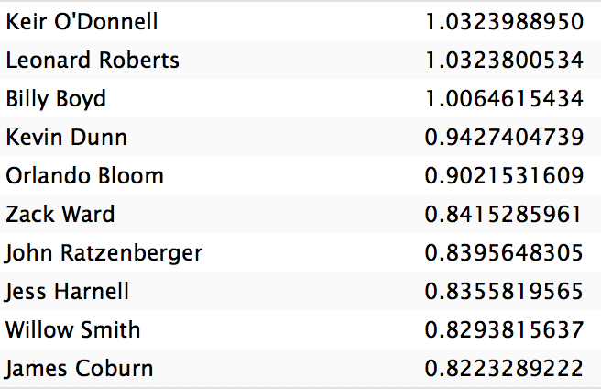
Analysis into Gross
1.63% actors contribute to gross
Actors – Highest Gross
Notes:
We assume that gross has relationship with both production and marketing process, thus gross is probably affected by factors including budget, duration and popularity of director and cast (which is reflected by Facebook likes). Additionally, gross is also affected by word-of-mouth marketing online, which could be reflected through IMDb score, number of voted users and number of critics for reviews.

Slide 18
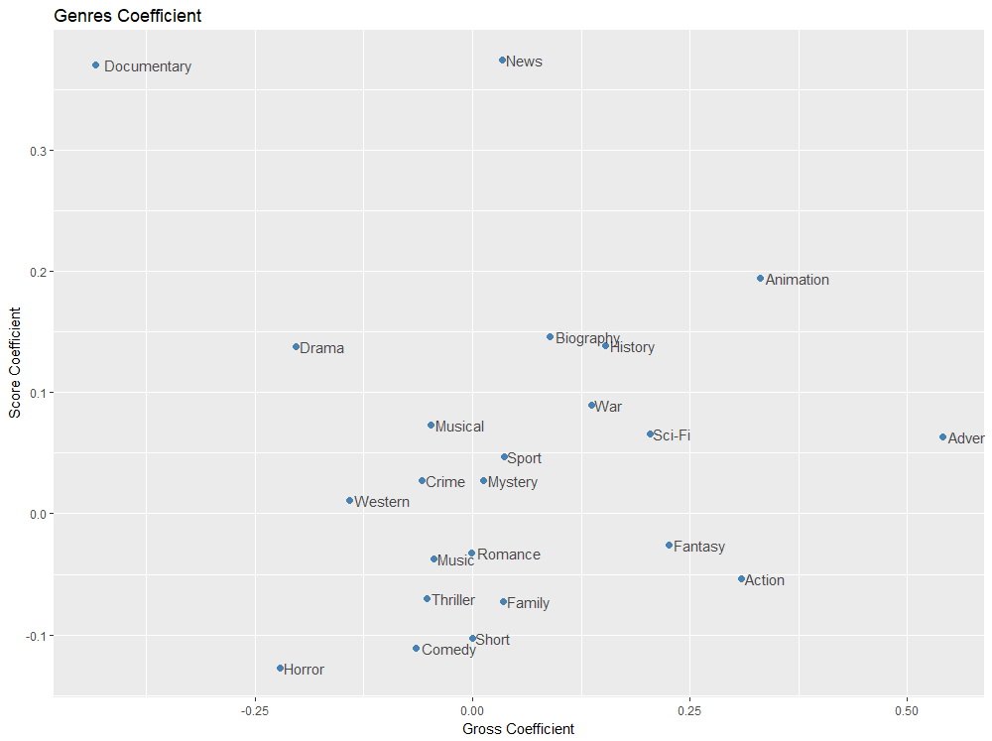
Conclusions
Cross-analysis into IMDb score and gross

Slide 19
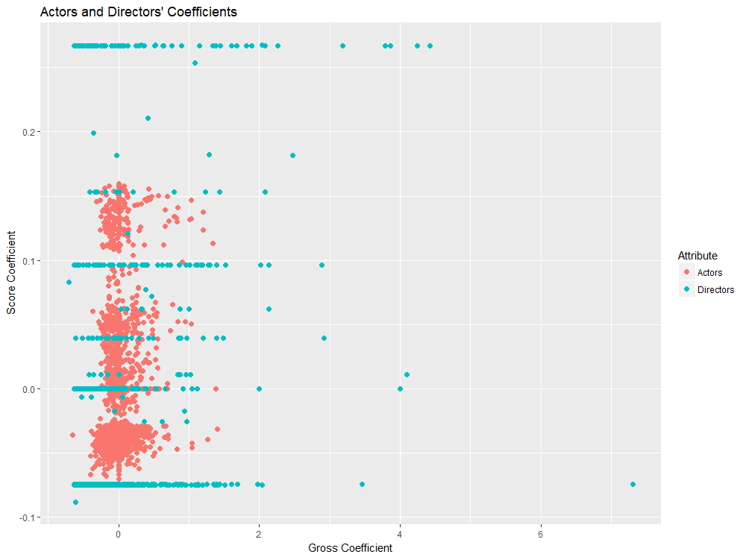
Conclusions

Slide 20
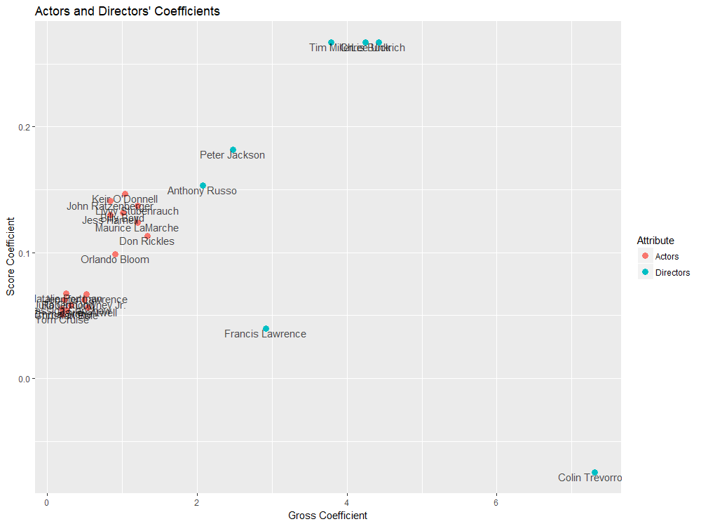
Conclusions
Directors
Chris Buck – Frozen/Tarzan
Lee Unkrich -- Toy Story 3/Finding Nemo/ Monster Inc.
Tim Miller -- Deadpool
Peter Jackson -- The Lord of Rings/ The Hobbit
Andrew Adamson -- Chronicles of Narnia/Shrek
Colin Trevorrow -- Jurassic World
Anthony Russo -- Captain America
Francis Lawrence -- Hunger Games/ I Am Legend
Actors
Livvy Stubenrauch -- Frozen
Maurice Lamarche -- Zootopia
Keir O’Donneil -- American Sniper
Billy Boyd -- The Lord of the Rings
Don Rickles -- Toy Story
John Ratzenberger -- Cars/ Toy Story/ Finding Nemo
Jess Harnell -- Up/ Car
Orlando Bloom -- The Lord of the Rings/ Pirates of Caribbean
Actors
Jennifer Lawrance — The Hunger Games
Hayley Atwell — Captain American/Avengers: Age of Ultron
Robert Downey Jr. — Iron Man
Christian Bale — The Dark Knight Rises
Natalie Portman — V for Vendetta
Julia Ormond — The Curious Case of Benjamin Button
Emma Stone — Bird Man/The Amazing Spider-Man
Tom Cruise — Mission: Impossible/ Edge of Tommorow

Slide 21
Conclusions
Genre
Animation is the most outstanding genre that behaves well both in gross profit and IMDb score.
Sci-Fi, History and Biography also are attractive genres.
Directors & Actors
Most outstanding actors are actually those dubbing actors in animation movies.
Overall, directors have stronger influence on gross than actors.

Slide 22
Program Improvements
Dataset excluding dubbing actors should be analyzed so as to identify actors who contribute to high gross and high IMDb score.
Animation movies could be further analyzed by collecting more variables.
IMDb score could be further analyzed as numerical variable.

Slide 23
Resources
Data from Kaggle
PowerPoint background from MyFreePPT.com

